Slide 1
Analytics 2.0
Deep Dive Architecture Review
1 November 2019

Slide 2
Executive Summary
Situation | Background
A2.0 business case refresh is presenting an opportunity to review architecture and identify changes needed to address potential issues that may be contributing to tenant adoption challenges in the areas of data access, data quality, system performance, and system availability. | A2.0 architecture conceived 4 years ago based on point-in-time maturity of data technologies and platforms. In the 4 years since A2.0 was conceived: Public cloud platforms have matured Technology options have increased Tenant use cases have evolved Modern source system interfaces available Enterprise recently adopting data governance and controls
Assessment (Key) | Recommendation
Data access performance: Technology and supporting data architecture design isn’t performant for tenants. Toolkit maturity: Data engineering toolkit used for data movement to Enriched/Tenant zone is not functional to the expectation of tenants. Engagement model: ADF team is focused on platform/associated tools and has not prioritized selecting best fit-for-use technologies or mitigating potential tenant challenges proactively | Evaluate and adopt right fit technology to support KP specific consumption patterns and scalable compute to support complex queries and concurrent usage. Review industry standard tools that supports building transformations in an intuitive manner quickly keeping in mind skillset availability. Similar review required for other toolkits. Shift to Right-to-Left tenant outcome-based engagement model and manage closely with tenants. Develop platform with tenant project requirements rather than only toward the platform vision

Slide 3
Outline
Executive Summary
Review Approach
A2.0 Architecture Overview
Summary of Key Recommendations
Findings and Recommendations
Architecture Review
Investment Drivers
Scenarios
Quality Goals
Architecture Decisions and Complexity
Architecture Views
Key Technical Recommendations Details
Azure Cloud Selection and Cost Example
Networking
Technology Standards
Data Management
DevOps CI/CD
Code Complexity
Performance and Capacity Planning
Support and Maintenance
Resiliency and Monitoring
Security
Risks
Appendix

Slide 4
Review Approach
Existing Architecture Documentation Review
Deep Dive Information Collection
Consultation with Microsoft and Cognizant
Tenant leaders and technical SME Interviews
Executive deep dive Architecture review
Team | Description | People
ARB Review Team | Performing deep dive review of Analytics 2.0 to inform its next business case refresh. Reviewing IT projects for Pre-CAC and for mySDLC phase gates regularly. | Rajiv Synghal and team, Chief Data Office Prashant Naik and team, Enterprise Architecture Karl Fankhauser and team, Enterprise Architecture
Cognizant Team | Data architecture consultants. Partnering with ARB team for deep dive. | Sampath Parthasarathy Rajesh Sreepada
A2.0 Tech Team | Provided ARB Review Team with documentation and information. | Ganesh Thondikulam and team
A2.0 Program Team | Program team and foundation data team. | Chris Guy Claudine Martin Steven Moss
Insight Team | Track in production. | Andy Petersons Brian Sikora
RADA Team | Track in production by EOY. | Shannon Madsen
NCAP Team | Track under development. | Vivian Tan Kathryn Clift David Martin | Jessica Yamashita Michael Honsa Susan Coffey
RMA Team | Track under development. | Erin Lamb
Member Month | Track under development. | Shady El-Daoushy
Finance Team | Track in pipeline. | Bill Sullivan Amarjit Hothi
In scope: Architecture and patterns review based on provided documentation. ADF Limited tenant solution architecture reviews Business case goals and objectives High-level alternative analysis Tenant feedback for functional review Out of scope: Deep dive design and code analysis Infrastructure configurations analysis Implementation verification Build consensus of recommendations across stakeholders Evaluation and selection of proposed technology alternatives Cost estimates of recommendations
Notes:
Have not conducted deep dive on: design and code analysis, configurations, architecture verification, consensus of recommendations across all stakeholders, cost estimates of recommendations

Slide 5
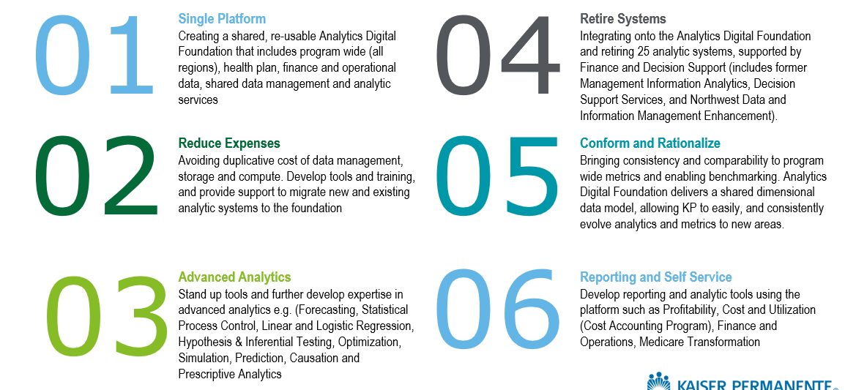

A2.0 Overview
Develop a shared, re-usable data and analytics foundational platform consisting of cost-effective and efficient foundation data zones – raw, refined and enriched and foundation services that meet current and future needs of our analytic tenants

Slide 6


















A2.0 Reference Architecture
Microsoft Application Natively Available in MS Azure
Third Party Application
Natively Available in MS Azure
Additional technologies to enable Analytics
Security
SYSTEMS OF ENGAGEMENT
SYSTEMS OF RECORD
SYSTEMS OF INTELLIGENCE
Data Stores
Visualization
Data Acquisition & Staging
Analytics Tools
Information Access and Delivery
Ingest
Hadoop
Data Warehouse and Data Marts
ADF Toolkit
/ DE Tool
Raw
Zone
Refined
Zone
Cortana Cognitive Services (AI)
Advanced Analytics / AI
Power BI
Azure SQL data warehouse
Azure ML Studio
Self-Service
In motion
Machine Learning
Stream
Spark
Bot Services
HBASE
Juypter Notebooks
Messaging
Kafka
HIVE
SQL Server
R Server
Azure ML
TEZ
At rest
LLAP
Analytic as a service APIs
Replicate
Enriched Zone
NoSQL
H2O
RDBMS connect
Cosmos Db
Azure Data Factory
User Defined Space
Azure Analysis Services
Text
Vision
Bot
File-Based
Standard BI and Analytics
Master and Reference Data Repositories
Power BI
Adapters
Azure Blob Storage
Azure Data Lake Storage
HDInsight
Recommend
Speech
Emotion
Tamr ( under evaluation )
Data Management
Meta Data
Tagging
Lineage
Lifecycle
Glossary
Data Governance
Data Quality
Apache Atlas
Waterline Data
Apache Atlas
Solix
Collibra
Collibra
Trifacta
External
Data
Key Vault
SafeNet
Kerberos
oauth2
IAM/RBAC
Authorization
Azure Keys
Encryption
Safenet
Key Management
Authentication
Ranger
Notes:
<<My suggestion – skip this slide altogether. There is another slide that is similar and more relevant>>

Slide 7
ADF Aligned to Strategy
What A2.0 is doing right:
Moving data platform to the cloud:
ADF is aligned with the vision.
Elastic and ephemeral analytics available with cloud.
Advanced analytics available on the cloud.
Envisioning for moving on-premise business intelligence to the cloud.
Data ingest tooling to raw and refined zones:
Built to near parity to current industry best practices.
Need to continue to mature (e.g. ingest performance, automated flows)
Data management plan: tagging, lineage, glossary are industry best practices
Data Access and Use Capabilities
Selection of ADLS for data object store.
Selection of PowerBI.

Slide 8
Summary of Key Recommendations
Topic | Recommendation
Azure open source / open source / commercial | The principle is “Open Standards First” but the approach is a restrictive “open source only”. This is perceived as a factor for not meeting tenant performance and delivery objectives. KP should evaluate and select technologies that best fit tenant usage patterns. Technologies have evolved over the last 3-4 years.
Data Engineering Toolkit custom development vs. proprietary ETL technology | Augment custom data engineering toolkit (DET) with vendor-supported products. Also, allow tenant selection of DET alternatives from KP standard options.
ADLS/Hive for Data Lake (Refined/Enriched) | Replace HD Insight and Hive with more current options (Databricks Spark / Delta Lake, Snowflake).
Use of ADLS/Hive to serve as analytics consumption layer vs. alternatives | Enable tenant flexibility in selecting technologies which are suitable to the specific uses in analytics consumption layer (Databricks/Snowflake/SQL DW, Cosmos, Graph, etc.).
Tenant outcome-based delivery | Shift to outcome-based engagement model using effective SAFe agile. Develop platform with tenant project requirements rather than driven by platform vision. Establish Center for Tenant Enablement.
Performance and reliability | More collaboration needed to understand data access patterns for optimal performance. Ensure proper data certification to build tenant trust. Incorporate performance testing in automated regression testing. Use end-to-end application monitoring to proactively address issues.
Cloud pay-for-use capability | Enable Jenkins pipelines to automate end-to-end infrastructure provisioning and just-in-time infrastructure for job processing, taking full advantage of cloud capabilities. Ensure tools support Continuous Integration / Continuous Deployment.
Platform availability | A severe issue. This requires deeper investigation to determine if there are issues beyond platform, testing, automation, and process.
Notes:
ADLS/Hive choices above lead to increased hops and increasing latency in tenant zone

Slide 9

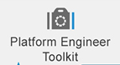
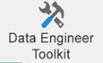





Architecture Recommendations
Augment custom data engineering toolkit (DET) with vendor-supported products Also, allow tenant selection of DET alternatives from KP standard options.
Replace HD Insight and Hive with more current options (Databricks Spark Cluster/Delta Lake, Snowflake).
Microsoft Application Native to MS Azure
Third Party Application Native to MS Azure
Additional technologies to enable Analytics
Hybrid Cloud
Security
Security
SYSTEMS OF ENGAGEMENT
SYSTEMS OF RECORD
SYSTEMS OF INTELLIGENCE
Data Acquisition & Staging
Data Stores
Analytics
Information Access & Delivery
Ingest
Refined
Zone
User
Zone
Enable tenant flexibility in selecting technologies which are suitable to the specific uses in analytics consumption layer (Databricks, Snowflake, SQLDW, Cosmos, Graph, etc.).
Data Analytics as a Service
Diagnostic/
Descriptive
Predictive & Prescriptive
Visualization
Portals
In motion
Replace HD Insight and Hive with more current options (Databricks Spark Cluster/Delta Lake, Snowflake) .
Stream
Power BI (IaaS)
Reporting
Data Discovery
Self-service
Power BI
Messaging
Enriched
Zone
Tenant
Zone
Operational Analytics
Dashboards
Business Intelligence
SQL Server Analysis Services (IaaS)
Advanced Analytics
Raw Zone
Statistical Modelling
Alerts
Replace with KP standard Confluent Kafka.
Real-Time Analytics
Azure ML Server-R
At rest
Natural Language Processing
Azure Machine Learning
Replicate
LLAP
Analytic as a service APIs
Archival Zone
TEZ
Online Analytical Processing
RDBMS connect
Express Routes
Azure SQL DB (IaaS)
Cognitive
Cortana
Text
Vision
Spark
Business Rules
HD Insight Hadoop
Ad-Hoc Analysis
Machine Learning
Recommend
Emotion
File-Based
Azure Data Lake Storage
Azure ML Studio
Adapters
Bot
Speech
Adapters
Continue to use ADLS for Raw Zone. Gen 2 upgrade is an opportunity to migrate to Databricks Spark Cluster.
Azure Data Lake Storage
HDInsight HBase
Azure Blob
Data Management
Data Management
Metadata
Tagging
Lineage
Data Governance
Data Quality
Master Data Management
Collibra
Waterline Data (IaaS)
Atlas
Collibra
Waterline Data
Tamr
External
Data
Enable analytic services on Azure. Currently only HDI and PowerBI. Databricks slated for 2020.
Key Mgmt.
Authentication
Authorization
Encryption
Key Vault
SafeNet
Kerberos
Ranger
Azure Encryption
Replace HBase with
Databricks Spark Cluster.
Enable KP standards for data management.
Components in red outlines not currently enabled.

Slide 10
Review Findings and Recommendations Page 1
Category | Finding Title | Finding Description | Implication | Recommendation
Performance | System performance inadequate. | Data access performance does not meet tenant expectations. Architecture was designed with limited knowledge of consumption patterns; therefore, some redesign, partitioning, and bucketing of tables to is needed to fit tenant usage. Limited choices of technologies for accessing data constrain tenant development. | Not using fit-for-use technologies and excessive effort on performance tuning lead to significant delays and cost overruns. | Provide new technology options in such as Databricks DeltaLake and Snowflake that adjust data distribution dynamically. Define process for reviewing data access patterns. Align solution roadmap with vendor roadmaps on a continuous basis.
Availability | Unstable dev environment. | Dev environment for tenants is not managed by ADF team to meet SLAs. | Tenants have an unstable work environment with unstable tools and unusable data, leading to delays and cost overruns. | Define, socialize, and monitor environment SLA's. Build separate platform dev and test environment for ADF team. Review technology options to manage the platform.
Engagement | Outcomes priority insufficient. | ADF team is focused on platforms and improving tools and has not prioritized selecting best fit-for-use technologies or mitigating potential tenant challenges proactively. ADF team is not sufficiently connected to EA and tenants. | Platform design disconnected from tenant expectations, technology trends, and IT strategy. | Shift to outcome-based engagement model and manage closely with tenants. Develop platform with tenant project requirements rather than only toward the platform vision. Adopt forward-engineering team concept to prove features through POCs ahead of project sprints.
Engineering | DE Toolkit maturity insufficient. | Data Engineering Toolkit is not meeting tenant functional and non-functional requirements. Performance, stability, and availability is lacking. Sustainability and Viability of this Toolkit should be assessed. | Tools not ready for production leading to tenant project delays. | Stabilize the DE Toolkit by augmenting custom solution with vendor-supported products Also, allow tenant selection of DET alternatives from KP standard options with standardized evaluation criteria meeting KP environment complexity and scalability
Supportability | KP custom development. | Custom build approach taken for many toolkits: data access, data operations, platform engineering, and data science. Commodity software could suffice A2.0 use cases at least 80%. | Ongoing custom development and long-term support is costly. | Review available industry tools such as Informatica, Talend, StreamSets, Databricks etc. Assess options for joint development. Analyze usage of persona-based toolkits. Provide A2.0 use cases and requirements for vendor near-term roadmap commitment. Implementation could be enhanced with these capabilities: No- or low-code pipeline Reusable pipelines and Flow templates Pre-built origins and destinations, template transformations, connectors & adaptors Reusable pipelines Data drift detection and correction Performance testing and comparison across versions

Slide 11
Review Findings and Recommendations Page 2
Category | Finding Title | Finding Description | Implication | Recommendation
Engineering | Incomplete automation pipeline. | ADF does not have full CI/CD and not working on the same code branch as tenants. Jenkins pipeline for infrastructure-as-code is not accounting for version changes and upgrades. Cluster not rebooted regularly to receive software updates. | Integration tests not automated, leading to more bugs and delays. Jenkins pipeline without end-to-end infrastructure and code configurations cause delays in the cloud. Without a fully automated build pipeline, the ADF only works like on-premise environments. | Automate integration testing and ensure ADF and tenants are using same tool versions. Fully build out Jenkins pipeline to automate end-to-end infrastructure provisioning, software configuration, and testing.
Security | Access controls not stable. | Data access and control via a unified security model requires more clarity to tenants. Access controls are sometimes lost during upgrades and new data loads. | Access control configuration lapses introduce security risk. Unavailable and misconfigured access delays projects. | Ranger support for all services need to reviewed and messaged appropriately.
Architecture | Zoned design not fully effective. | Zoned architecture is sound but tenants may be working around the design to send data straight to tenant zone. | Data reuse opportunity lost. | Enable robust data certification of refined/enriched zones for tenants to trust, consume, and contribute to. Collaborate with tenant teams to avoid non-standard and extraneous data hops and integrations. Explore other technology solutions to further reduce duplication.
Transition | System migration improvements. | Legacy system migration acceleration plans for both data and processing need reviews and socialization. | Insufficient preparation may lead to discovering migration challenges later and delaying project. | Historical data migration and catchup strategy need to be qualified for key tenants. Processing migration also can be accelerated.
Quality | Test data management strategy | When moving from Dev to Prod Support data integrity and performance is impacted. Workflow breakage is introduced. | Tenant frustration, missed timelines Rework and increased costs. | Follow consistent data management processes and use enterprise test data tools
Architecture | Azure Event Hub vs. Confluent | KP is standardizing on Confluent Kafka across on-premise, Azure and IBM Cloud |  | Standardize on using Confluent Kafka vs. Azure Event Hub
Architecture | Data sharing not defined | Data exchange and services use cases are not directly addressed in the architecture. Need patterns for bi-directional use cases. | Platform design disconnected from tenant expectations, technology trends, and IT strategy. | Include data marketplace features in future roadmap.

Slide 12
Review Findings and Recommendations Page 3
Category | Finding Title | Finding Description | Implication | Recommendation
Supportability | Limited team bandwidth. | Single A2.0 team is supporting platform ops, platform development, and tenant projects. | As the product moves to an enterprise supported platform need to verify that it can be supported by organization. | Partner with IT Ops and CAS to evaluate supportability and support delegation opportunities. Enable further tenant autonomy. Invest in COTS to reduce custom development and support. Develop Center for Enablement to accelerate projects, share knowledge, and promote best practices.
Cost Management | Cost management needs further review. | Forecasting, cost control and chargeback requires further review. | Unclear cost model is a cost risk for tenants. | Develop more accurate forecasting and processes based on past experience. Socialize with tenants.
Data Management | Data management constraints. | Tenants don’t perceive immediate value on tagging. Where possible supplying less curated data may allow the tenant to achieve business value sooner. | Inhibits responsiveness of ADF team. | Explore ways to tag data retroactively after loads. Explore more automated tagging capabilities
Data Management | Enterprise Catalogue used for partial capabilities. | Integration from ADF back to Collibra was dropped from the scope of A20. | This will limit the visibility data stewards have to the use of their data on the SOI platform | Define data governance requirements and select fit-for-use tool.
Data Management | Enterprise data quality or data preparation not used. | Trifacta and Informatica are KP tech standards for data quality, but neither is in use by A2.0. Trifacta is also an enterprise data preparation tool. | Data quality is not assured and may lead to errors in reports. | Define data quality and data preparation requirements and select fit-for-use tool.
Security | Use of PowerBI Gateway. | PowerBI Gateway was introduced to mitigate application identity risk of PowerBI using the Azure Public IP service tag. | PowerBI Gateway introduces performance impact. | Azure set to enhance PowerBI with private IP to meet TRO requirements by Q1 2020.
Security | Use of cloud-only accounts. | Legacy identities created on Azure Active Directory Domain Services is set to retire. | Unmanaged identities pose a security risk. | Continue existing effort to retire these non-KP identities and migrate ACLs to use KP AD identities.
Architecture | Serverless compute solution pattern | Just-in-time and serverless compute as offered by combination of Azure Functions and Databricks not yet explored. | Opportunity to further reduce cost. | Identify best-fit tenant use cases and implement solution pattern.
Architecture | On-premise tools | Data is being brought back from Azure to on-premise to support existing tools (e.g. Cognos, SAS). | Increased cost, latency | Enterprise should define containment criteria. Options to review: Move to cloud, connect from on-premise to Azure, look at alternative solutions

Slide 13
A2.0 Tenant Expectations and Feedback
Recently released data engineering pipeline is not stable. Audit Balance and Control, Job Scheduler, Tagging and Security tools are still in development.
Environment stability a problem. May be down for two days. DE Tool hangs.
Automated provisioning of environments not there yet. Not a seamless process. Not enough transparency to the environment provisioning, and costs.
Issues with data getting loaded. Incorrect data. Testing looks correct but then production is not correct. No patient IDs. Timestamps missing. DOB errors.
Tools required to access the data are available and integrated.
Data is available on the platform.
Data pipelines are scalable and repeatable.
Data is refreshed at the required frequency.
Platform is available, responsive, and highly performant.
Queries unable to complete. Could not find cause. Suggested to partition, etc.: not practical at scale.
Self-service enabled.
When accessed, surface data from the correct layer.
OneLink QA data can't join to Clarity QA data. (ADF needs a central de-identification service to use prod data so that Dev and QA data can be joined.)
Automated testing and validation.
Data and functional parity to existing solution.
Envisioned managed data warehouse with less dependency on IT plus more capabilities. Bill it to the end user. So far not the case.

Slide 14
Next Steps
Review and finalize key recommendations
Choose right-fit technology option with KP specific criteria to meet Tenant needs
Deep-dive in to the different toolkits, compare with industry tools and suggest way-forward
Review engagement model for Tenant collaboration to delivery business benefits and outcomes
Develop actionable implementation roadmap

Slide 15
Architecture Review
KP ARB Review Analytics 2.0

Slide 16
Business Case Investment Drivers
Investment Drivers | Strategic Drivers KP’s Shared Agenda, particularly the Affordability Bold Move, and other strategic initiatives have many unmet data and analytic needs. Creating predictive models and taking advantage of other advanced analytic techniques is a significant challenge because KP’s rich data is not readily accessible. Furthermore, analysts lack consistent and enabled technologies for machine learning, deep learning and artificial intelligence. Operational Drivers Complexity of KP’s data infrastructure and processes make it challenging for decision makers to access right insights in a timely fashion. This results in decisions being made without the necessary information. Financial Drivers Between the Finance and Decision Support (includes former Management Information Analytics, Decision Support Services and Northwest Data and Information Management Enhancement) departments, there are 25 supported analytic assets; these assets are complex and expensive to support and have a high level of duplication. Exorbitant resources, time and effort are required to get consistent, high quality, program-wide data. KP’s most valuable analysts spend the majority of their time preparing and cleansing data, instead of driving value by developing new insights.

Slide 17
Business Case Executive Summary
Project Description | Analytics 2.0 (A2O) delivers efficiencies: Creating a shared, re-usable analytics digital foundation that includes program wide (all regions), health plan, finance and operational data and shared data management and analytic services on a single platform. The analytics digital foundation can be re-used, reducing the expense of future analytic projects, and avoiding duplicative cost of data management, storage and computation. A2O will develop tools, training and support to migrate new and existing analytic systems to the foundation. Integrating onto the analytics digital foundation, and retiring 25 analytic systems, supported by Finance and Decision Support (includes former Management Information Analytics, Decision Support Services and Northwest Data and Information Management Enhancement). Conforming and rationalizing duplicative data, business rules and definitions, bringing consistency and comparability to program wide metrics and enabling benchmarking. Delivers a shared dimensional data model, allowing KP to easily, and consistently evolve analytics and metrics to new areas. A2O delivers enhanced capabilities: Creates new analytic tenants on the analytics digital foundation, with new dashboards and program wide metrics that support apples-to-apples comparison of key performance indicators for Regional Presidents, national and regional senior executives and regional and functional leaders. Presidents dashboard, highly reliable operating model, operating plan dashboard 50+ program wide metrics across 10 domains (quality, service, access) with drill to detail Develops new and extended analytic and data management services, including a common portal, integrated master and reference data, a shared data catalog and integrated data quality and validation rules. Supports open source software and creation of standard data schemas, allowing KP to leverage industry predictive models and artificial intelligence libraries.
Key Benefits | Reduces the size of the analytic infrastructure by rationalizing and integrating data. Consolidates regional and functional data onto a common technical platform. Establishes single source that targeted decision makers can rely upon. Improves quality, consistency and timeliness of information for decision-makers. Enables development of innovative, near-time analytic models. Enables broader self-service capabilities that allow decision makers to answer their own questions. Supports KP’s strategic priorities, particularly affordability, by enabling expedited identification and evaluation of opportunities. Reduces time spent on data preparation and cleansing, increases insights and analytic yield. Speeds up development of new capabilities by reusing technology infrastructure. Enables reuse of the analytics digital foundation (foundation services and foundation data). Reduces IT and business staff required to administer analytic systems.
Notes:
Follow formatting requirements on pages 22-23. Two pages maximum for Executive Summary.
Additional Guidelines
If an investment is driven by regulatory requirements, please cite the applicable regulations.
If an investment is based on a certain expected membership / patient volume, please cite the supporting source (i.e., an approved strategic plan, officially published updates, or other verifiable source).
Amendments: Describe what original assumptions have changed, and why.

Slide 18
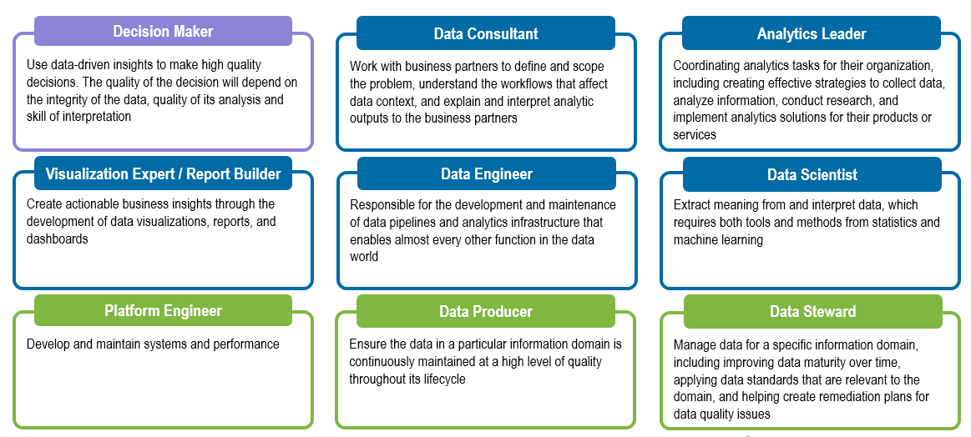
ADF Personas and Architecturally-Significant Scenarios ( )

Slide 19
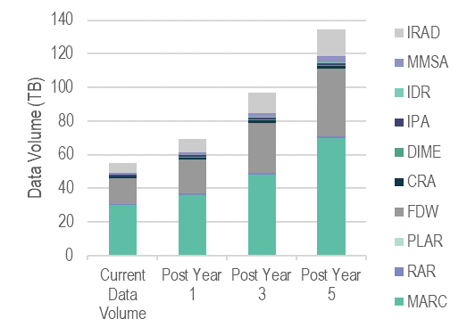
Quality Goals and Non-Functional Requirements
CAPACITY
UTILIZATION
The total number of existing active user is over 12000 across all assets
Potentially, around 1200 concurrent users across the entire platform (not including the ones with unlimited user access)
There is no centralized team to manage the utilization. Utilization is monitored, measured, and governed by different groups for each asset
DATA AVAILABILITY & RETENTION
4 assets purge data annually or on an ad-hoc basis, but a few assets do not have any existing purge strategy
Snapshot are completed on a incremental / daily / weekly / monthly / quarterly frequency based on business requirements
Data retention and archival policy varied between 7-10 years with some assets currently lacking a policy
SCALABILITY & PERFORMANCE
Currently, KPIT, SAE and Shared Analytics are the teams to keep the assets scalable and high performing
Upgrade Environment & Purchase New Server Space are the two common methods to improve the performance
DATA LOADS
Typical run time (duration) for jobs across all assets varied from 3 hours to 15 hours. For PLAR, it could take up to 200 hours for the jobs to complete
Cut-off time for jobs vary between 3am PST and 9am PST. Some jobs do not require cut-off time
SECURITY
Security is set-up via: DB level, Role-base, Tool-Base, Authentication and Authorization, etc.
Internal teams are responsible for the security such as: KPIM, SAE, KPIT, etc.
Each asset has its own tool/process for auditing
Non-functional requirements responses from Tenants should be revisited to clarify questions and close gaps
NOTE

Slide 20
Quality Goals
Attributes | Goal | How Addressed
Accessibility | KP staff and partners should be able to securely access the platform, data, and tools with authorization. | Integration with KP Active Directory, Kerberos, Apache Ranger & Atlas enable the authentication & authorization process
Auditability | Platform should provide audit trails of all actions including but not limited to security incidents, data access, and tool access. | System and application logs from all components of the framework are captured, monitored and reported on. There is a plan to integrate with enterprise Splunk tool.
Compliance | Platform, data, and tools should be fully compliant with regulations such as HIPPA and SOX. | All applicable components of the framework are selected after verifying that they are HIPPA compliant.
Cost Visibility | Platform should provide accurate and up-to-date costs incurred for operating the platform. | Microsoft Azure provide near real-time reports of charges.
Extensibility | Platform should add new tools and data integrations without impacting existing framework. | With separation of concerns as a design principle and modular design, the framework allows addition of new tools without much re-work. Also, Microsoft Azure is a cloud platform that makes it easier to add new tools.
Monitoring | All user and system activities are monitored. | Logging in all framework components is enabled, the logs are monitored and reports are generated on important metrics, such as, on data access, performance, access denials, and so on.
Performance | Performance is measured and SLAs are met. | Data load, availability, and reporting metrics are captured and the framework architecture allows for horizontal scaling to meet SLAs.
Resiliency | Architecture should be able to identify and absorb source data issues and data pipeline failures. | Framework has built-in capabilities (e.g. Audit, Balance, and Control – ABC, data ingestion framework, etc.) to detect issues and restart the data load without data loss.
Robustness | System should not fail with unforeseen events from data and compute cluster issues | Data ingestion framework has built-in capabilities to detect issues upfront such as incorrect data types and record formats, etc.
Scalability | Platform should scale up or down different components according to demand. | Framework utilizes scalable technologies ADLS, Spark, Kafka, HBase, LLAP on MS Azure public cloud.
Security | Platform, data, and tools should be fully secured per KP Standards. | Architecture deploys KP approved technology standards for security: AD, Kerberos, KeyVault, Ranger, etc. to secure the platform. In addition, all components and applications go through security scans to identify any security vulnerabilities.
Testability | Ensure system and pipelines testing is repeatable and automated. | Automated testing and benchmarking tools are enabled with a combination of ABC, APDP, and performance metrics collection during data ingestion and reporting.

Slide 21
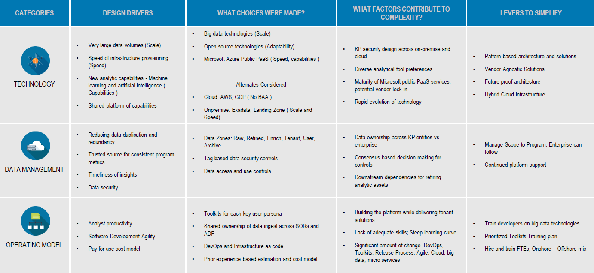
Architecture Decisions and Complexity

Slide 22
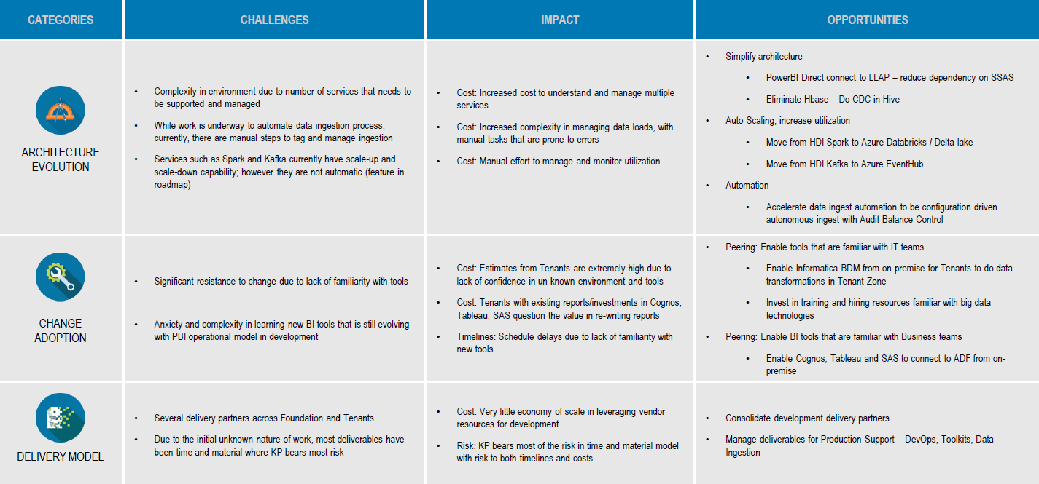
Architecture Decisions and Complexity

Slide 23
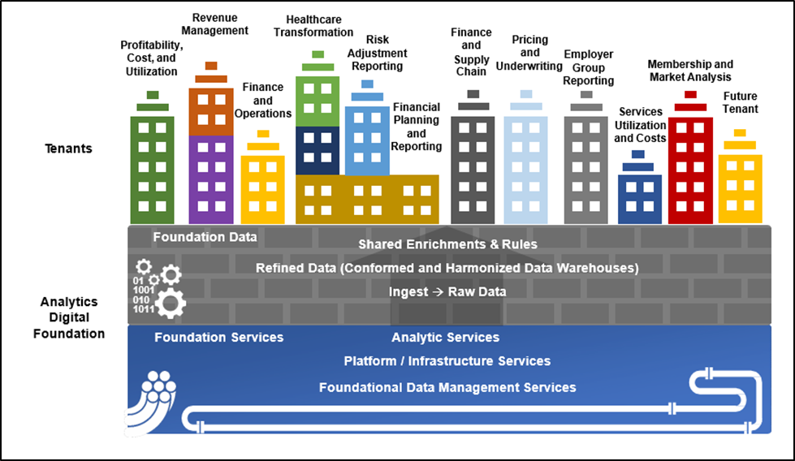
System Context

Slide 24

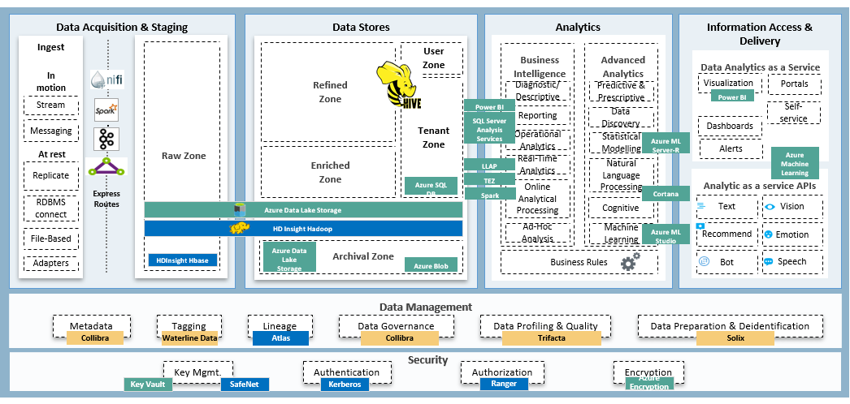
ADF Architecture
DE Toolkit
KP Architecture Review Board © 2019 Kaiser Permanente Confidential - Internal Use Only

Slide 25
ADF Cloud/On-Premise Hybrid Approach (Phase 1 - 2019)
Phase 1 “Build and Integrate” architecture leverages a hybrid approach with on-premise and cloud components.
Landing zone will continue supporting existing tenants.
Cloudera CDH distribution
Enable common control plane, toolkits, and capabilities across on-premise and cloud.
Hortonworks distribution on-premise (HDP) and cloud (HDI)

Slide 26







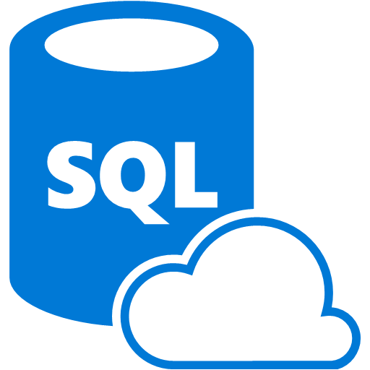





Future State Pattern – Data Ingest and Staging
Azure – Analytics Digital Foundation
On-premises network
Pattern 1: Files Pushed from On-Prem
Files from On-premise staging servers will be pushed to ADLS via NiFi
Pattern 2: Files/Data Pulled from On-Prem
Based on Schedule/event , ADF pipeline trigger the pull of files from On-premise staging servers to adls
Event based trigger will enable the files copied to ADLS using NIFI / ADF
Pattern 3: Events transfer from on-premise
Secure end point enabled for all event API through API gateway
Events from on-premise will be pushed to Event Hub
ADF Toolkit will be listening to Event hub and trigger the data load
Non-Hadoop Compute
1
AKS Kubernetes
Infra Components
ADF Toolkit Components
2
3
Source Systems
Other DBs
RDBMS
1 – 10 Gbps
Hadoop Compute
Compute
Others
3
Azure Batch
Event Hub
1
2
Insert ADF Toolkit Icon
Azure Data Stores
ADF Raw/ Stagingg Area (Linux Box)
ADF Toolkit + Azure Data Factory
Event/Schedule
Pull data/files from Source systems
2
Trigger
Pull – API
Push – Event Grid
SQL DB
Raw Data
Audit and Balance Controls
Profile and Tag
NIFI
(Push)
Cosmos DB
Azure Redis Cache
Visualization and Analytics Tool
Microsoft Feedback
Microsoft proposed exploring usage of Event Grid with Azure Functions in 2018. This could potentially reduce the need of Kafka for batch.
KP / Microsoft alignment: Azure functions is part of serverless compute and PHI,PII data currently cannot be processed through it, due to security requirements of requiring on KP VNET.
Will explore further as Azure Functions and Event Grid fall under KP Unmanaged scenario which will require KP specific security hardening
Events
Event Source
API
Gateway
3
Files Moved to staging
PowerBI
ADLS Gen V2
Hive

Slide 27

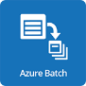

Future State Pattern – Data Compute and Store
Azure – Analytics Digital Foundation
On-premises network
Azure – Analytics Digital Foundation
Data Processing
Dataflows will be built using ADF Toolkit and Azure Data Factory 2.0
Tenant Dataflow will be built using Informatica BDM
Databricks will be used for Hadoop based computation.
Non Hadoop compute includes executing in Kubernetes, Scalable VMs and Serverless compute
Serverless compute will be used only for non-PHI, non-PII workloads
Storage will be ADLS ; Raw, Refined & Enriched: Hive; Tenant Zone: Hive, SQL Server 2019
Data Processing – Polybase
SQL Server 2019 with polybase enabled ( processing is pushed to Hadoop compute engine without copying data locally)
1
ADF Toolkit + Azure Data Factory V2
ELT Flow
Audit and Balance Controls
Schedulers
Raw to Refined Data Flow
Refined to Enriched Zone Data Flow
Enriched Zone to Tenant Zone Data Flow
Profile and Tag
Event Based Triggers
1
1 – 10 Gbps
Source Systems
1
Other DBs
RDBMS
Non Hadoop Compute
Azure Data Stores
Container
Scalable VMs
AKS Kubernetes (Central US)
Infra Components
ADF Toolkit Components
SQL DB
Azure Batch
Hadoop Compute
Cosmos DB
Informatica BDM
2
Azure Redis Cache
1
2
Microsoft Feedback
Microsoft aligned on the usage of HDInsight Cluster workloads until Azure Databricks supports authorization using Policy management & capture with Atlas (data lineage) and Ranger (data policies) features become available
Raw Zone
Refined Zone
Enriched Zone
Tenant Zone
ADLS

Slide 28
Future State Pattern – Data Management
On-premises network
Azure – Analytics Digital Foundation
1
Atlas will provide ability to maintain data catalog[technical], tags, schema and support policy authoring in a multi tenant mode
Atlas will push the Data catalog [schema] information along with tags to Ranger
All Ranger instance will leverage centralized Ranger policy store
Ranger policies will be enforced through Hive Engine
Azure Data Catalog V2.0 (Future State)
ATLAS features will be integrated for data management
Ranger features will be integrated for policy management
Ranger will manage policy across Hive, Hbase and SQL Servers
3
Data catalog v2.0
Future State
ATLAS
RANGER
Catalog data
Create Tags
Profile Data
Policy Management
Policy Application
1 – 10 Gbps
3
2
Azure Data Stores
Hadoop Compute
3
3
Centralized Data Management Tools
HDInsight
LLAP
ATLAS
SQL DB
Schema updates are pushed to Atlas
RANGER
SQL Server Roles and Permission
1
Microsoft Feedback
Microsoft aligned on the KP choice of Apache Atlas (data lineage) and Ranger (data policies)
Next step is to work with MSFT to incorporate KP requirement into Data Catalog V2.0 design
1
1
RANGER
Centralized Ranger Policy Store
2
Ranger Policies are applied through Hive
PolyBase
Raw Zone
Refined Zone
Enriched Zone
Tenant Zone
ADLS

Slide 29


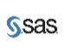
Future State Pattern – Data Visualization and Access
Azure – Analytics Digital Foundation
Data Visualization
1
Data Visualization tools connects to HDInsight cluster& SQL Server for data
HDInsight Clusters (Hive) connect to ADLS to get data and compute locally
Azure Databricks integration is in progress
MSFT team is working on a SaaS offering ( 400 TB limitation) which includes PowerBI- visualization Azure Databricks – Compute + ADLS Gen 2 – Storage
On-Prem
Azure
PowerBI
Cognos
Tableau
SAS
PowerBI
1
Connects to analysis services added as data source in the gateway
Data Stores
Hadoop Compute
Microsoft Feedback
Microsoft aligned on using ADLS as storage and not replicating the data to SQLDB /SQL DW for supporting visualization needs
MSFT is working on a SaaS offering that includes Azure Databricks as compute engine
HDInsight
LLAP
SQL Server 2019
1
Refined Zone
Enriched Zone
Tenant Zone
ADLS

Slide 30





Future State Pattern – Data Science
Azure – Analytics Digital Foundation
Azure – Analytics Digital Foundation
On-premises network
Insert ADF Toolkit Icon
Data Science tools connects to HDInsight cluster& SQL Server for data
HDInsight Clusters (Hive) connect to ADLS to get data and compute locally
Azure Databricks integration will provide IDE and Hadoop Compute required for Data Science model
ADF Toolkit
AI and Machine Learning
1
Model Repository
Feature Repository
Model Management & Collaboration
Bot Services
IDEs
Cognitive Services
1
1
Data Stores
Hadoop Compute+ IDE
1
HDInsight
LLAP
SQL Server 2019
BI Tools
1
Refined Zone
Enriched Zone
Tenant Zone
ADLS

Slide 31
ADF Architecture Current State with Recommendations
Microsoft Application Native to MS Azure
Third Party Application Native to MS Azure
Additional technologies to enable Analytics
Components in red outlines not currently enabled.
Hybrid Cloud
Security
Security
SYSTEMS OF ENGAGEMENT
SYSTEMS OF RECORD
SYSTEMS OF INTELLIGENCE
Data Acquisition & Staging
Data Stores
Analytics
Information Access & Delivery
Ingest
1
2
Refined
Zone
User
Zone
Data Analytics as a Service
Replace Hive / Curated Layer with Databricks Delta Lake / Snowflake / SQL DW
Visualization
4
Diagnostic/
Descriptive
Predictive & Prescriptive
Portals
In motion
Replace DE Tool for ETL with Talend / Informatica BDM / StreamSets.
Stream
Replace Platform Engineering Toolkit for Ingest and DE Toolkit for ETL with Talend / Informatica BDM / StreamSets.
Reporting
Data Discovery
Power BI (IaaS)
Power BI
Self-service
Messaging
Enriched
Zone
Tenant
Zone
Operational Analytics
Dashboards
Business Intelligence
SQL Server Analysis Services (IaaS)
Advanced Analytics
Raw Zone
Statistical Modelling
Alerts
Replace with KP standard Confluent Kafka
Real-Time Analytics
Azure ML Server-R
At rest
Natural Language Processing
Azure Machine Learning
Replicate
LLAP
Analytic as a service APIs
Archival Zone
TEZ
Online Analytical Processing
RDBMS connect
Express Routes
Azure SQL DB (IaaS)
Cognitive
Cortana
Text
Vision
Spark
Business Rules
HD Insight Hadoop
5
Ad-Hoc Analysis
Machine Learning
Recommend
Emotion
File-Based
Replace HD Insight with Databricks Spark Cluster and enable JIT elastic cloud capability
Azure Data Lake Storage
6
Azure ML Studio
Bot
Speech
Adapters
Adapters
Azure Data Lake Storage
7
HDInsight HBase
Azure Blob
Continue to use ADLS for Raw Zone
Replace HBase with
Databricks Spark Cluster
Data Management
Data Management
Metadata
Tagging
Lineage
Data Governance
Data Quality
Master Data Management
Collibra
Waterline Data (IaaS)
Atlas
Collibra
Waterline Data
Tamr
External
Data
Key Mgmt.
Authentication
Authorization
Encryption
Key Vault
SafeNet
Kerberos
Ranger
Azure Encryption
Do enable KP standards for data management

Slide 32
Key Technical Recommendations
Marker | Component | Finding Description | Implication | Recommendation
 | Platform Engineering Toolkit | Platform engineering toolkit - Is using Airflow - DAG(s), NIFI, HDI Kafka for ingestion of source data (on-prem) to the Raw zone on Azure Ingest Scripts and DAG's are developed Manifest and Metadata management is Fairly working well | ETL vendor tools can be used to ingest reducing complexity in maintaining open source software in the long run | Replace HDI Kafka with Confluent Kafka which is the enterprise version of Kafka Evaluate vendor tools like Talend, Informatica BDM and/or Stream Sets for ingest capabilities and replace the platform engineering toolkit with vendor supported tools
 | Data Engineering Toolkit | KP Custom Developed Toolkit maturity is insufficient Data Engineering Toolkit is not meeting tenant functional and non-functional requirements. Performance, stability, and availability is lacking. Flows built in DE Toolkit had once taken 200 times longer than tenants' own methods. Custom build approach taken for many toolkits: data access, data operations, platform engineering, and data science. Commodity software could suffice A2.0 use cases at least 80%. | Ongoing custom development and long-term support is costly. Will have Supportability issues on an ongoing basis | Review available industry tools such as Informatica, Talend, StreamSets, etc., skillset availability, training requirements, tenant adoption, and business outcomes. Analyze usage of these persona-based toolkits. Provide A2.0 use cases and requirements for vendor near-term roadmap commitment. Replace DE Tool for ETL with Talend / Informatica BDM or Stream Sets - Later evaluate to extend these tools to replace ingestion also Underlying Engine/Cluster could be Data Bricks Spark Cluster
1
2

Slide 33
Key Technical Recommendations
Marker | Component | Finding Description | Implication | Recommendation
 | Hive / Ambari UI | Hive is very restrictive in nature Hive is having issues accommodating incremental loads, CDC and merges Tenants are finding it difficult to change and adopt SQL scripts and joins don't work the same way as traditional environments Ambari UI lacks all traditional SQL Query tool capabilities | Hive is creating major data quality, performance, usability and adoptability issues | Replace Curated Layer (Enriched - Refined) with Databricks Delta Lake, Snowflake or SQL DW
 | HD Insights / ADLS / HBASE | HD Insights services like HBASE, Hive and Spark are mainly being used as processing engine for ETL HDI Hbase which being used for CDC is not working as intended It has the auto-scale capabilities but does not have the elastic capabilities | If curated layer is replaced with other options there is no need to have HD Insights Continuing to use HBASE created additional complexities to manage regions and scan optimizations etc. | Replace Curated Layer (Enriched - Refined) with Databricks Delta Lake, Snowflake or SQL DW Underlying Engine/Cluster could be a Data Bricks Spark Cluster providing elastic JIT capabilites Underlying storage for Databricks Delta Lake / Snowflake or SQL DW can use ADLS
3
4
5
6

Slide 34
Detailed Review
KP ARB Review Analytics 2.0

Slide 35

Cloud Platform Selection (2016)
Azure Technology
Identified leader in public cloud with a rich set of features and capabilities.
Developer friendly integration (Linux and Windows based).
Microsoft #1 Contributor of Open Source projects on Github.
Hybrid Cloud option available with Azure Stack (Azure on premise).
Support and integration with many technology platforms of interest to KP (Docker Containers (Linux and Windows), Kubernetes, Mesosphere, Hadoop, IOT and Blockchain).
Existing Relationship
Leverage existing relationship based on Office 365.
Azure Express Route networking interconnect already in place.
Existing Microsoft licenses can be extended and utilized in the cloud.
KP Active Directory already integrated with Azure.
BAA already in place with Microsoft.
At the time, BAA failed with Amazon. No BAA with Google. Google’s offering was also less mature.

Slide 36
A2.0 Platform Cost Model with RADA
The Azure estimation model for the RADA Dev Environment is outlined below.
The actual Azure cost for the environment for Oct 2018 was $15.5K.
Service type | Custom name | Region | Description | Estimated Cost
HDInsight | Spark | East US | Spark Component: 2 D13 (8 cores, 56 GB RAM) Head nodes x 730 Hours, 4 D13V2 (8 cores, 56 GB RAM) Region nodes x 730 Hours, 1 D13V2 (8 cores, 56 GB RAM) Edge nodes x 730 Hours | $3,820.24
HDInsight | Kafka | East US | Kafka Component: 2 D13V2 (8 cores, 56 GB RAM) Head nodes x 730 Hours, 4 D13V2 (8 cores, 56 GB RAM) Region nodes x 730 Hours, 3 D13V2 (8 cores, 56 GB RAM) Zookeeper nodes x 730 Hours, 1 D12V2 (4 cores, 28 GB RAM) Edge nodes x 730 Hours, 4 Standard disks | $5,348.45
HDInsight | Hbase | East US | HBase Component: 2 D13V2 (8 cores, 56 GB RAM) Head nodes x 730 Hours, 4 D13V2 (8 cores, 56 GB RAM) Region nodes x 730 Hours, 3 D13V2 (8 cores, 56 GB RAM) Zookeeper nodes x 730 Hours, 1 D12V2 (4 cores, 28 GB RAM) Edge nodes x 730 Hours | $5,184.61
Azure Data Lake Storage | Storage | East US 2 | Pay-as-you-go: 5 TB Storage, 10000 Read Transactions, 1000 Write Transactions | $289.68
Azure SQL Database | Framework Metadata | West US 2 | Elastic Pool, DTU Purchase Model, Premium Tier, 125 eDTUs: 1024 GB included storage per pool, 50 DBs per pool, 1 Pool(s) x 730 Hours, 5 GB Retention | $684.38
Azure Kubernetes Service (AKS) | Application Pods | West US | 6 A4 (8 vCPU(s), 14 GB RAM) nodes x 730 Hours; Pay as you go; 6 managed OS disks – S40 | $2,593.92
Container Registry | Application | West US 2 | Standard Tier, 1 units x 30 days, 1 TB Bandwidth, 0 GB Extra Storage | $108.65
Support |  |  | Support | $0.00
 |  |  | Licensing Program | Microsoft Online Services Program (MOSP)
 |  |  | Monthly Total | $18,029.91
Disclaimer
All prices shown are in US Dollar ($). This is a summary estimate, not a quote. For up to date pricing information please visit https://azure.microsoft.com/pricing/calculator/
This estimate was created at 11/15/2018 7:24:00 PM UTC.

Slide 37
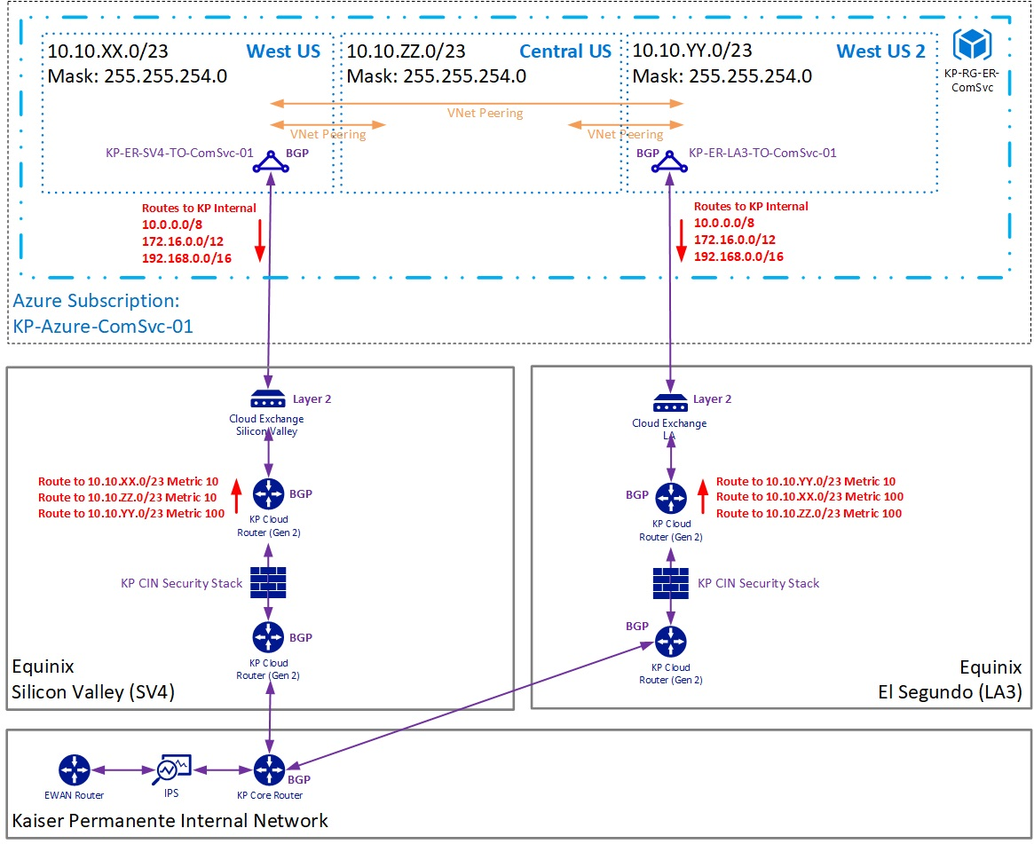
Networking
ExpressRoute Link | Status
Primary | 1Gb in place; configurable to 10Gb.
Secondary | 1Gb in place on standby.
Disaster Recovery | Planned.
ExpressRoute Cost | Cost (August 2019)
1Gb Monthly Fee | $1,186
1Gb Metered Usage | $1,511
August 2019 Total | $2,697
5Gb Upgrade Est. | $12,735
10Gb Upgrade Est.* | $25,470
Network usage so far has not exceeded 50% of bandwidth limit.
* Dual 5Gb links

Slide 38
Technology Standards – Azure Technologies in KP Catalog
Product Version Name | Phase | Phase End Date | L3 Category | A2.0 Persona | A2.0 Status
Azure Container Service - ACS latest from Azure | Divest | 12/30/2019 | Container Service | Platform Operations | In use
Azure Redis Cache - Latest | Evaluation | 3/30/2020 | Big Data Platform | Data Engineer | Not used
Azure Machine Learning Studio - Latest | Evaluation | 11/29/2019 | Advanced Analytics - Artificial Intelligence | Data Scientist | Not used
Azure Data Factory - Latest | Evaluation | 12/30/2019 | Extract, Transformation & Load Tools | Data Engineer | Not used
Azure Cosmos DB - Latest | Evaluation | 3/20/2020 | NoSQL Database | Data Engineer | In use
Microsoft Azure - Virtual Network - Cloud | Leverage | 12/30/2030 | Virtual Networking | Platform Operations | In use
Microsoft Azure - SQL Server PaaS\ SQL DB PaaS - Cloud | Leverage | 12/30/2030 | Relational Database | Data Engineer | Not used
Microsoft Azure - SQL Datawarehouse - Cloud | Leverage | 5/30/2021 | Relational Database | Data Engineer | Not used
Microsoft Azure - Power BI - Cloud | Leverage | 12/30/2030 | Advanced Analytics - Artificial Intelligence | Data Consultant | In use
Microsoft Azure - Monitor - Cloud | Leverage | 12/30/2030 | Alerts and Monitoring Tools | Platform Engineer | In use
Microsoft Azure - Metrics and Alerts - Cloud | Leverage | 12/30/2030 | Alerts and Monitoring Tools | Platform Operations | In use
Microsoft Azure - Load Balancer - Cloud | Leverage | 12/30/2030 | Load Balancer & Proxy | Platform Operations | In use
Microsoft Azure - KP to Azure Private(IAAS) Connectivity | Leverage | 12/30/2030 | Virtual Networking | Platform Operations | In use
Microsoft Azure - Key Vault - Cloud | Leverage | 5/30/2021 | Key Management | Platform Operations | In use
Microsoft Azure - HDInsight (Spark) - Cloud | Leverage | 12/30/2030 | Big Data Analytics | Data Engineer | In use
Microsoft Azure - HDInsight (Kafka) - Cloud | Leverage | 12/30/2030 | Streaming | Data Engineer | In use
Microsoft Azure - HDInsight (HBase) - Cloud | Leverage | 12/30/2030 | Big Data Platform | Data Engineer | In use
Microsoft Azure - Express Route - Cloud | Leverage | 12/30/2030 | Virtual Networking | Platform Operations | In use
Microsoft Azure - Data Lake Store - Cloud | Leverage | 12/30/2030 | Big Data Platform | Platform Operations | In use
Microsoft Azure - Blob Storage - Cloud | Leverage | 12/30/2030 | Big Data Platform | Platform Operations | In use
Microsoft Azure - Activity Logs and Alerts - Cloud | Leverage | 12/30/2020 | Alerts and Monitoring Tools | Platform Operations | In use
Azure OMS - Latest | Leverage | 5/30/2021 | Log Management | Platform Operations | Not used
Azure CLI (Common Language Infrastructure) - Latest | Leverage | 5/30/2021 | Build and Deploy | Platform Engineer | In use
Azure Application Insight - Latest | Leverage | 5/30/2021 | Log Management | Platform Operations | Not used

Slide 39
Technology Standards – Other A2.0 Technologies in KP Catalog
Component Name | Phase | Phase End Date | Standards Category (L3) | A2.0 Persona | A2.0 Status
Sparkflow | N/A | N/A | Extract, Transformation & Load Tools | Data Engineer | In use
Aysadi | Evaluation | 3/31/2020 | Data Science Products | Data Scientist | Not used
KenSci | Evaluation | 3/31/2020 | Data Science Products | Data Scientist | Not used
SAS Viya | Evaluation | 12/31/2019 | Advanced Analytics - Artificial Intelligence | Data Scientist | Not used
Apache Airflow | Emerging | 5/31/2020 | Data Job Scheduling | Data Engineer | In use
Collibra Data Governance Center (DGC) | Emerging | 10/31/2019 | Governance & Stewardship | Data Consultant, Steward | Not used
Apache Atlas | Leverage | 5/31/2021 | Data Catalog | Data Consultant, Steward | Not used
Apache HBase | Leverage | 5/31/2021 | NoSQL Database | Data Engineer | Not used
Apache Nifi | Leverage | 5/31/2021 | Extract, Transformation & Load Tools | Data Engineer | In use
Apache Ranger (Policy Management) | Leverage | 5/31/2021 | Authorization | Data Consultant, Steward, Scientist | In use
ARM Templates | Leverage | 5/31/2021 | Build and Deploy | Data Engineer | In use
Groovy | Leverage | 5/31/2021 | Development Languages | Data Engineer | In use
H2O Slater | Leverage | 5/31/2021 | Data Science Products | Data Scientist | Not used
HDInsight Hive | Leverage | 5/31/2021 | NoSQL Database | Data Engineer | In use
KeyCloak | Leverage | 5/31/2021 | Authorization | Platform Operations | In use
RStudio | Leverage | 5/31/2021 | Analytics as a Service | Data Scientist | Not used
RStudio Server Pro | Leverage | 6/1/2021 | Analytics as a Service | Data Scientist | Not used
Sqoop | Leverage | 5/31/2021 | Extract, Transformation & Load Tools | Data Engineer | In use
The Jupyter Notebook | Leverage | 5/31/2021 | Analytics as a Service | Data Scientist | Not used
Zeppelin | Leverage | 5/31/2021 | Analytics as a Service | Data Scientist | Not used
Waterline Data | Leverage | 5/31/2021 | Advanced Analytics - Artificial Intelligence | Data Consultant, Steward, Scientist | Not used
Continued KP development on Sparkflow is an ongoing support and agility risk.

Slide 40
Data Management and Tools
A2.0 has done significant work to operationalize data management tools with some automation. However, setting up a new ingest can take up to two months. Design-time automation of DataOps appears to require additional maturity.
Automation and Orchestration | Implementation could probably be extended but appears to be missing capabilities for:
 | No/Low Code pipeline Flow templates Pre-built origins, destinations Pre-built template transformations Reusable pipelines Monitoring Topology of pipelines and interconnected pipelines | SLA management, automated actions/alerts Add or upgrade Data Management tools Data drift detection and correction Performance testing and comparison across versions Design/Deploy/Operationalize support Connectors/Adaptors Data Protection – discover/secure sensitive data
Tagging | Waterline and Atlas tagging tools have been integrated into the solution.
Adaptive Data Mastering | TAMR has been identified as an ADM tool. However, it is not standard, is not fully operational, and has not been used in context of A20.
Data Quality | Trifacta and Informatica tools have been identified as standards for Data Quality. A2.0 has had no requirements and did no integration with these tools therefore delivering no Data Quality capabilities.
Lineage | Integration with Atlas for lineage purposes is a significant new capability for KP’s DataOps.
Data Preparation | A2.0 has had no requirements for Data Preparation and did no integration with Trifacta; therefore, it is delivering no Data Preparation capabilities.
Governance | Integration from DataOps back to Collibra was dropped from the scope of A2.0. This will limit the visibility data stewards have to the use of their data on the SOI platform.
Security | Integration with Ranger is a significant piece of engineering to support DataOps.
Catalogue | Collibra data definitions are extracted and consumed by Waterline for tagging. However, integration from DataOps back to Collibra was dropped from the scope of A2.0. This is a significant gap to meet Enterprise capabilities.

Slide 41
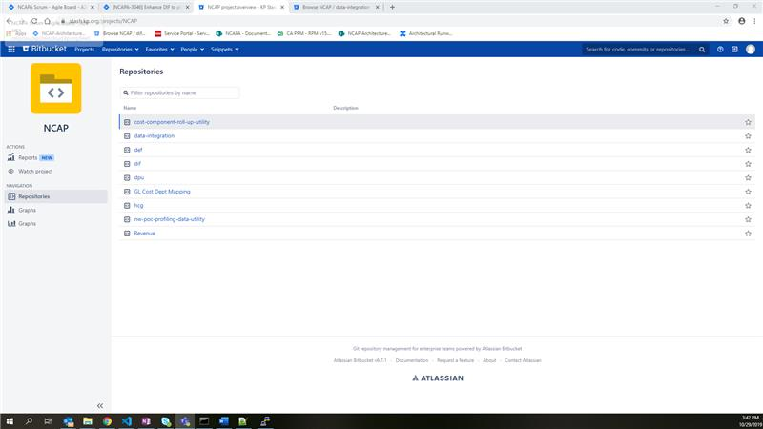
DevOps and CI/CD
Significant investment made to DevOps pipeline with over 45k lines of code. Example configuration for tenant NCAP: https://stash.kp.org/projects/NCAP.
However, Data Engineering Toolkit does not seem to support CI/CD. Used 3 sprints to deploy to tenant.
Findings
Cluster not being re-spun regularly to take advantage of software updates, indicating automation insufficiencies.
Continuous integration and testing not in place.

Slide 42
Code Complexity
DevOps Sector | Description | Components/Utilities | Stack | Lines
Azure Infrastructure | ARM (Azure resource manager) Parameter files | Secure -> Spark, Kafka, HBase, LLAP, Hadoop Non-Secure -> Spark, Kafka, HBase | AZ CLI, Jenkins, Groovy, Json | 1650
 | ARM (Azure resource manager) Template files | Secure -> Spark, Kafka, HBase, LLAP, Hadoop Non-Secure -> Spark, Kafka, HBase | AZ CLI, Jenkins, Groovy, Json | 3424
Deployment Templates | DevOps build groovy files | DevOps build groovy files | Groovy, Python, Shell, Docker, Yaml | 3808
 | Jenkins files setup - Jenkins pipeline files | Jenkins files setup | Groovy, Python, Shell, Docker, Yaml | 435976
 | Jenkins Shared Library | Common libraries used across the build and deployment process | Groovy, Python, Json, Yaml | 7737
 | Configuration files | Configuration files for framework - generic configuration files used in overall DevOps | Groovy, Python, Shell, Docker, Yaml | 3795
Kubernetes Package Manager | Helm templates | Helm templates | Helm, Yaml, Json, Docker, Shell, GO | 22945
Containerization | Docker-base images | Docker-base images | Docker, Shell, Python | 5125
DevOps Tools and Automation | Custom Utilities: AKV Sync, ADLS Upload, Azure resources whitelisting, cluster scaling | Utilities custom | Groovy, Python, Shell, Json, Yaml, AZ, Ansible | 2309
 | Custom tools and automation: Data Engineer, SonarQube, KeyVault Comparison, Get AKV Secret, Ansible scripts for HDinsight clusters | DevOps custom tools and automation | Groovy, Python, Shell, Json, Yaml, AZ, Ansible | 24446
Overall Total |  |  |  | 511215
DE Toolkit not included above.

Slide 43
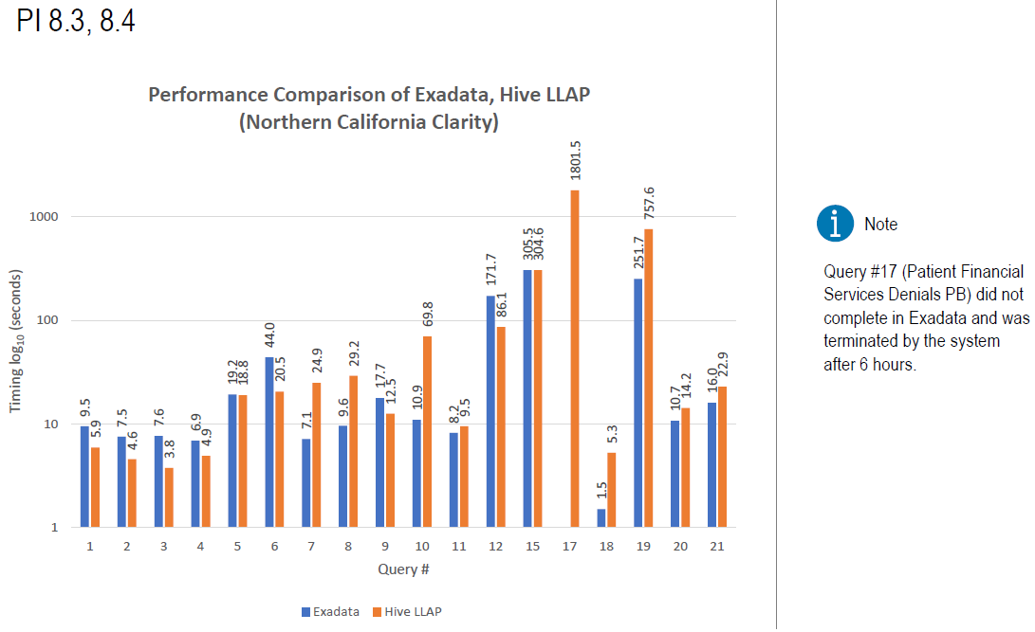
Performance and Capacity Planning
NW testing (left) shows comparable performance vs. Oracle Exadata.
However, Hive performance in other types of workloads (e.g. dimensional models) perform poorly or do not finish.
Tenant queries continue to need manual tuning, partitioning, and bucketing. Hints and explain plans from DE Toolkit were not effective.
2019 Capacity | 2020 Capacity Est. | 2021 Capacity Est.
700 TB | 1.2 PB | 3PB

Slide 44
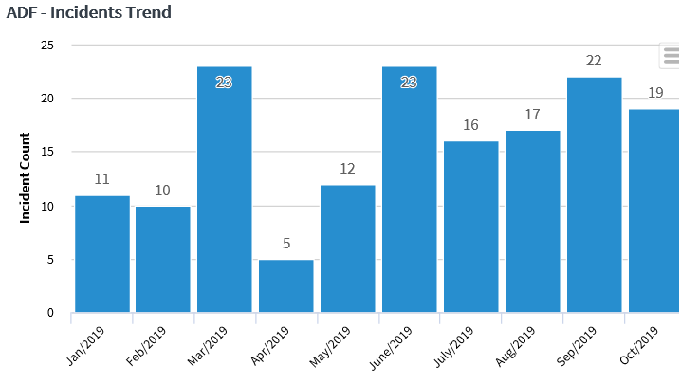
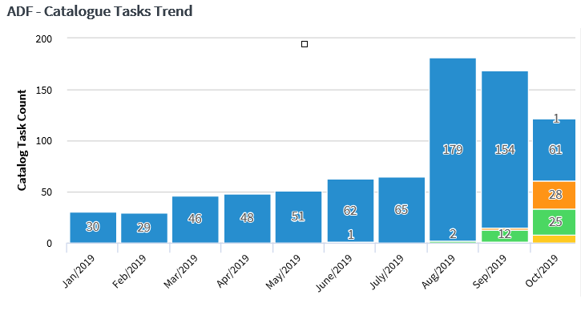
Support: ADF Environment Incidents and Service Task Status (YTD)
INCIDENT STATUS
SERVICE TASK STATUS
Incidents YTD-147, Resolved-144, In Progress- 4 The open incidents are related to DE performance and are being worked on with NCAP team
YTD -Tasks – 805, Resolved – 726, In Progress- 79
42% of open requests are related to access requests, 5% are related to deployment requests and 53% are related to non-prod issues and other requests
Note: All non-prod requests are now being submitted as SNOW requests (as opposed to email or Jira requests as done in the past, hence there is an increase in SNOW requests in August)

Slide 45
Support: High-Priority Microsoft Issues 10/11/2019 to 10/17/2019
S.No | Reported on | Issues Reported | Environment | Resolution | Duration (In min) | Status
1 | 10/11/2019 | Ambari Hive View is down in PROD | PROD | Clusters are hung, Rebooted the clusters with the help of MSFT. RCA is in progress. | 120 | Resolved
2 | 10/11/2019 | Ambari Hive View is down in PROD SUP | PROD SUP | Clusters are hung, Rebooted the clusters with the help of MSFT. RCA is in progress. | 300 | Resolved
3 | 10/17/2019 | Data Loss in FD Sandbox/DEV environment | FD Sandbox | In FD Sand box, users started complaining about their data loss. Upon investigation, found that data files are missing from the cluster. Restored the data from backup with the help of Microsoft. | 600 | Resolved
Case Number (Urgent) | Case Description | Case Status | Date Created
119041723002638 | Unable to browse folder contents using azure data explorer | Closed | 17-Apr-2019 21:56 PM
119043025002158 | scaling cluster via az cli results in cli error however portal shows successful and logs don't show success or failure | Closed | 30-Apr-2019 23:04 PM
119041126002896 | Hiverserver 2 is down | Closed | 11-Apr-2019 22:50 PM
119041523002415 | Best practices for querying Azure AD | Closed | 15-Apr-2019 18:41 PM
119041126002531 | Heartbeat Lost on the services | Closed | 11-Apr-2019 19:14 PM
119041122002435 | PREM | SEV B 24X7 | Azure HD Insights | Closed | 11-Apr-2019 19:25 PM
119052326003154 | Receiving errors when deploying updates, need help troubleshooting | Closed | 23-May-2019 21:21 PM
119061021001981 | az login --use-device-code error: 400 and server response: {'error':'invalid_request','error_description':'AADSTS220050 | Closed | 10-Jun-2019 21:50 PM
119061421002052 | OMSAgentForLinux can't be deployed successfully on azcloudxnp009 | Closed | 14-Jun-2019 19:03 PM
119063021000055 | Unexpected Create or Update Virtual Machine activity | Closed | 30-Jun-2019 03:22 AM
119071621003219 | azcloudxp003 shows failed to start, isn't patching | Closed | 16-Jul-2019 22:07 PM
119080521001962 | ER Alert rule creation fails | Closed | 05-Aug-2019 19:13 PM
119080821002189 | device login URL not working https://www.microsoft.com/devicelogin | Closed | 08-Aug-2019 20:45 PM
119081021000075 | Quota request for HDInsight | Closed | 10-Aug-2019 00:31 AM
119081321000198 | Can't upgrade the cluster due to missing LOGs service | Closed | 13-Aug-2019 01:32 AM
119092521001408 | NSG Rules Via Azure Terraform Module | Closed | 25-Sep-2019 16:37 PM
119100421002469 | NMP Alets are not working | Troubleshooting | 04-Oct-2019 22:25 PM
119102121001799 | hditesting & win2012-ad are unavailable for update management | - | 21-Oct-2019 18:58 PM

Slide 46
Support: ADF Environment Availability 10/11/2019 to 10/17/2019
DATA ENGINEER
Env | Agreed Service Time (AST) in Hrs | DownTime (Within AST) in Hrs | DownTime (Outside AST) in Hrs | % Available
DEV | 105 | 10 | 0 | 90%
QA | 105 | 0 | 0 | 100%
UAT | 105 | 0 | 0 | 100%
PROD SUP | 105 | 0 | 0 | 100%
PROD | 105 | 0 | 0 | 100%
DE Tool in FD-QA/UAT environments was 100% available for users DE tool in FD DEV/Sandbox – Had issues due to missing data. Restored the data files from storage backup PROD & PROD SUP– Hive Availability was impacted since the cluster services are hung. Restarted the services with the help of MSFT has helped to fix the issue. RCA is in progress
AMBARI
Env | Agreed Service Time (AST) in Hrs | DownTime (Within AST) in Hrs | DownTime (Outside AST) in Hrs | % Available
DEV | 105 | 0 | 0 | 100%
QA | 105 | 0 | 0 | 100%
UAT | 105 | 0 | 0 | 100%
PROD SUP | 105 | 4 | 0 | 96%
PROD | 105 | 2 | 0 | 98%
Agreed service time (AST) No of Hours between Sunday 9 PM PST and Friday 6 PM PST = 117 No of Hours for maintenance/planned downtime between 6 PM-9 PM M-Th = 12 AST = 117-12 = 105 Hours AST - DT % Availability = ------------- * 100% AST
Support Team | Comment
ADF Team | Recent availability 90% or better.
Microsoft | 80% tickets are due to Azure skills gap.
Tenant Tracks | Cluster could be down for two days. Queries run 2-3 hours then fail.

Slide 47
Support: Open Microsoft Incidents as of 10/17/2019
5 Microsoft tickets are pending for resolution / RCA – Follow Up In Progress
MICROSOFT OPEN ISSUES
Case Number | Incident Description | Environment | Triage Steps | Comments/Root Cause
119091221000561 | Spark stderr & stdout and Thread dump are not accessible | FD Sandbox | We are unable to access Spark stderr or stdout logs and we are getting error- "The site cannot be reached" | Pending RCA with MSFT
119092521001982 | Hive, ranger services are not accessible | FD Sandbox | ranger admin could not be started. When we started it through Ambari agent, it seems that Ambari agent does not startup the java process and then wait for ranger admin to generate logs. Decided to reboot all worker nodes and tried again. After that, hive server2 interactive service started successfully | Pending RCA with MSFT
119092521001982 | Ambari Hive view is not accessible (Reopened) | PROD SUP | Ambari Hive view is not accessible in PROD SUP environment. Unable to reboot the clusters. Worked with MSFT to reboot the cluster. | Pending RCA with MSFT
119101121001720 | Ambari Hive view is not accessible | PROD | Ambari Hive view is not accessible in PROD SUP environment. Unable to reboot the clusters. Worked with MSFT to reboot the cluster. Initial triage shows it is due to port conflict issue. Reaching out MSFT to get the patch for fixing this issue | Pending RCA with MSFT
119101721002082 | Data Loss in FD Sandbox/DEV environment | FD Sandbox | In FD Sand box, users started complaining about their data loss. Upon investigation, found that data files are missing from the cluster. Restored the data from backup with the help of Microsoft | Pending RCA with MSFT

Slide 48
Resiliency and Monitoring
High Availability | Description / Technology
ADF Azure | Cluster HA across nodes.
ADF On-Prem | Cluster HA across nodes.
Disaster Recovery | Class of Service | Primary Location | Redundancy Location | Description / Technology
ADF Azure DR | 3 | US West 2 | US West Central | Azure paired regions replication.
ADF On-Prem DR | 3 | KP Pleasanton | TBD | TBD
CAS planning for full automation of rebuilding ADF clusters and applications upon recovery in Q1 2020.
Monitoring | Description / Technology
MS Azure Monitor | Currently used by CAS team.
KP TRO Splunk | Currently receiving security events.
KP Enterprise Splunk | Future applications using Azure Kubernetes Service (AKS) may send data to on-prem Enterprise Splunk.
Recommend A2.0 ADF and tenant teams explore monitoring and reporting requirements and leverage Azure Monitor or Application Insights as needed.

Slide 49
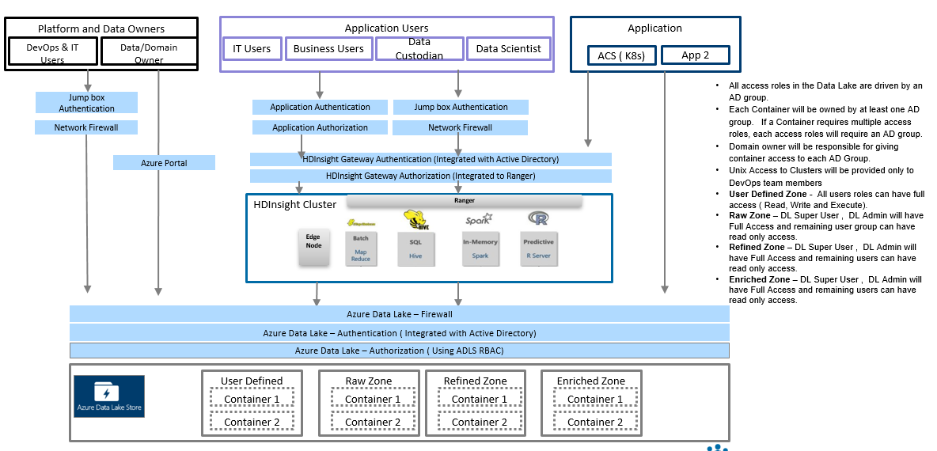
Security Architecture – Data (1 of 5)
Data in transit and at rest are all encrypted.

Slide 50
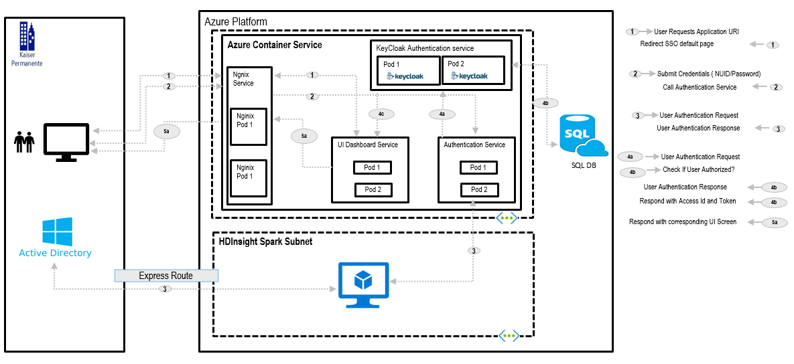
Security Architecture – Services (2 of 5)
Data in transit and at rest are all encrypted.

Slide 51
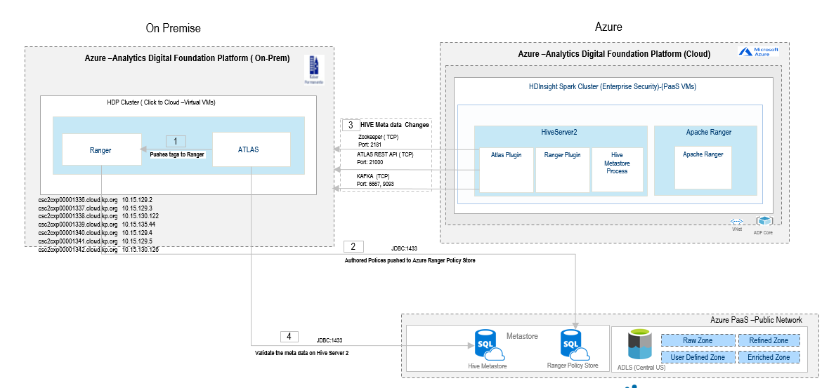
Security Architecture – Tagging and Policy Administration (3 of 5)

Slide 52
Security Architecture – Details (4 of 5)
TRO Intake # | Vendor Risk Mgmt. | Controls Integration | Cybersecurity Architecture | Pen. Test / Red Team | App Sec
PRJ0000532 | Yes | Yes | Yes | Yes | Yes
Domain | Component | Security Control
Identity and Access Mgmt. | Single Sign-On | N/A
 | Authentication | KP Active Directory synchronized to Azure Active Directory.
 | Authorization | Enforced through AD groups and managed with Apache Ranger. Job role matrix being implemented.
Data Protection | Data in Transit | MS Azure encryption.
 | Data at Rest | MS Azure encryption w/ AES 256.
 | Data Loss Protection | N/A
 | Key Management | MS Azure Key Vault.
Network Security | Perimeter Protection | MS Azure identity perimeter best practices.
 | Trust Zone Boundary Protection | ExpressRoute and MS Peering.
 | Vendor Remote Access | N/A
Application Security | Penetration Testing | Red Team performed testing in 2018.
 | Vulnerability Analysis | AppSec team performed SAST and DAST scans.
Platform Security | Platform Image | KP image for Azure with Hyper-V extensions.
 | Platform Hardening | Compliant with KP TSS.
 | Malware Protection | Cylance (to verify migrated from McAfee EPO).
 | Systems Assurance | IaaS enrolled in standard TRO Qualys systems assurance compliance scans. PaaS components lacking compliance scans.
Platform IAM | Credential Vaulting | MS Azure Key Vault.
 | Elevated Access | KP using Unix Access Management (UAM) for IaaS access. KP has no OS access to hosts for PaaS. KP has no elevated OS access to HDInsight.
Security Event Monitoring | Application Events | Events collected by KP Enterprise Splunk.
 | Security Events | Events collected by TRO Cyber Risk Defense Center.
 | Local Logging | MS Azure OSM and MS Azure Application Insight.
Physical Security | Physical Access Control | MS layered physical security.

Slide 53
Security Architecture – TRO Current Risks Excerpt (5 of 5)
Risk Descriptions | Potential Impact | Likelihood | Risk Level
AC-01 - Lack of access control procedures that mandate restricted access to information, information processing systems or applications and sensitive enterprise processes based on a need to know basis, may result in inconsistent application of access controls across KP, leading to accidental or deliberate misuse of access privileges. | Significant | Unlikely | Medium
RA-03 - Inadequate assessment and prioritization of risks against established risk acceptance criteria and irregular risk reporting to management may expose the operating environment to potential threats or vulnerabilities. | Significant | Unlikely | Medium
SC-02 - Lack of appropriate safeguards for application partitioning with respect to user functionality and privileged access may lead to the risk of improper security design, data loss, and data corruption. | Significant | Unlikely | Medium
SC-07 - Inadequate safeguards to secure KP's network perimeter may result in successful cyber attacks and unauthorized access by malicious parties. | Significant | Unlikely | Medium
Risk Response
Acceptance Rationale | Business drivers for new analytics functionality require usage of Microsoft Azure services on a tight timeline. All medium items could not be closed or mitigated prior to launch of the Azure platform due to resource and time constraints. The impact of not accepting the risk would be delays and possible cost overruns for the following programs: Metrics and Analytics for Revenue Cycle (MARC) Next-gen Cost Accounting Program (NCAP) Analytics 2.0 Delays are estimated to cost $500,000 to $1M/month.
Mitigating Factors | There are no compensating controls for the outstanding items above and beyond the required control set.

Slide 54
A2.0 Risk Tracker – Open Risks (Excerpt, Most Recent)
ID | Track | Description | Date | Requestor | Likelihood | Impact | Project Impact | Escalation
142 | Foundation Data Management | Tag mapping is currently a manual process. Given the volume of columns that need to be mapped we have received feedback from the SOR teams that the process may not be sustainable and is incredibly resource intensive. | 10/25/2019 | Kimberly D Brooks | High | High | ​Delays in delivering committed items which at present have not been identified. | No
141 | ADF Toolkits/Enablement | NCAP BCP decisions and designs have a risk of making the security of the ADF fundamentally more complicated both from a design and an implementation perspective | 10/24/2019 | Lisa A Gros | Medium | Medium | ​Complexity of Data Access and Use implementation on ADF | No
135 | Data Delivery | Our SOR partners from CDTS would like to jointly review and approve the ADF change management process to consume planned KPHC Clarity upgrades​ | 10/16/2019 | Prasad J. Shenoy | Medium | High | Might ​impact ability to go to Prod for KPHC-Clarity data without the necessary approvals | No
129 | Foundation Data Management | ​Collibra Refresh - Scope and Timeline Unknown | 10/7/2019 | Kimberly D Brooks | High | Medium | Delays | No
128 | Foundation Data Management | ​Resource needs for shared objectives | 10/7/2019 | Kimberly D Brooks | High | Low |  | No
127 | Foundation Data Management | ​Appointment of Functional Data Stewards; risk without functional data stewards in place the a20 program is responsible for completing activities that would traditionally be performed by the data steward i.e. collibra attestations, meta data management | 10/7/2019 | Kimberly D Brooks | High | Low |  | No
124 | Foundational Data | ​If we are unable to project and count on commitments for provisioning access, our schedules will be repeatedly in danger of slipping. | 7/23/2019 | Jean Richardson | High | Medium | ​Schedule | Yes
122 | Architecture Runway | ​AR PI9 Objective #10 - Hierarchy Management - Tech POC/TRO Assessment - no NDA in place; placed this item on the dependency matrix also | 9/27/2019 | Kimberly D Brooks | High | High | ​May impact AR's ability to deliver on scope items for objective #10 Hierarchy Management - SP3M-965 | No
121 | Architecture Runway | AR objectives in PI9 that require participation of team members outside of Architectural Runway may be at risk due to the availability of other team resources. | 9/27/2019 | Kimberly D Brooks | High | High | AR's ability to deliver objectives that require external resources outside of AR may be delayed and not delivered in PI9. AR is dependent upon other team resources in order to complete objectives in PI9. | No
120 | Architecture Runway | ​Track Lead/Product Owner capacityis limited to deliver PI9 Objective #8 below. There could be delays which will effect AR ability to complete this objective in PI9. | 9/27/2019 | Kimberly D Brooks | High | High | ​There could be delays which will effect AR ability to complete this objective in PI9. | No
119 | Architecture Runway | ​Too many stretch goals and too many objectives in PI9 for the AR. The risk includes not being able to complete the objectives due to capacity/shared resources - RAID #71 | 9/27/2019 | Kimberly D Brooks | High | High | ​Delays in delivering objectives | No

Slide 55
Appendix
KP ARB Review Analytics 2.0

Slide 56
A2.0 Current State Tools View
Microsoft Application Natively Available in MS Azure
Third Party Application
Natively Available in MS Azure
Additional technologies to enable Analytics
Components marked red not currently enabled.
Security
SYSTEMS OF ENGAGEMENT
SYSTEMS OF RECORD
SYSTEMS OF INTELLIGENCE
Data Stores
Visualization
Data Acquisition & Staging
Analytics Tools
Information Access and Delivery
2
Ingest
ADF Toolkits / DE Tool
Hadoop
Data Warehouse and Data Marts
Raw
Zone
Refined
Zone
Cortana Cognitive Services (AI)
1
Advanced Analytics / AI
Azure SQL data warehouse
3
Machine Learning
Power BI (IaaS)
In motion
Azure ML Studio
Self-Service
Stream
Spark / DE Tool
Bot Services
HBASE
Juypter Notebooks
Messaging
Kafka / DE Tool
HIVE
SQL Server (IaaS)
R Server
Azure ML
TEZ
At rest
LLAP
Analytic as a service APIs
Replicate
Enriched Zone
H2O
RDBMS connect
NoSQL
SQL Server Analysis Services (IaaS)
Azure Data Factory
User Defined Space
Cosmos Db
Standard BI and Analytics
File-Based
Azure Analysis Services
Text
Vision
Bot
Master and Reference Data Repositories
Power BI
Adapters
Azure Blob Storage
Azure Data Lake Storage
HDInsight
Recommend
Speech
Emotion
Tamr ( under evaluation )
Data Management
Meta Data
Tagging
Lineage
Lifecycle
Glossary
Data Governance
Data Quality
Apache Atlas
Waterline Data (IaaS)
Apache Atlas
Solix
Collibra
Collibra
Trifacta
External
Data
Key Vault
SafeNet
Kerberos
oauth2
IAM/RBAC
Authorization
Azure Keys
Encryption
Safenet
Key Management
Authentication
Ranger

Slide 57
A2.0 Tenant Track Comments
Category | Comment
Availability | Asked for 95% availability incl. offshore accessibility. Currently is 80% availability or 90% availability.
Availability | Environment stability due to tool changes. Environment access very limited, but now better. Environment stability a problem. May be down for two days. DE Tool hangs.
Compatibility | Pattern presented was Hive SSAS PowerBI. Asked how pattern specifically could work. Ex.: Ranger does not work with SSAS. Technical team not evolving architecture to respond to feedback.
Compatibility | Older version numbers of Hive causing issues with the compaction reader. Cannot be read by Sparkflow DE Tool. Can't use interactive Hive. For merging, people using Hive to Spark back to Hive. Unique key generator having issues with Hive version numbers and bugs. Waiting for fixes, upgrades, etc.
Cost | Cost and predictability unclear. Couldn't tell that A2.0 could save money by going to ADF.
Cost | Don't want to spend members' premium for KP to build software (i.e. Build vs. Buy).
Cost | 1/3 ROI from retiring assets. 2/3 ROI from developing new analytics. But if we do not retire the legacy assets, we expose the org to high risks: operational disruptions, etc.
Cost | Have to lengthen testing cycles.
DevOps | Automated provisioning of environments not there yet. Not a seamless process. Not enough transparency to the environment provisioning, and costs.
DevOps | Getting pre-prod could take 6 months!
DevOps | Just getting access takes 6 weeks.
Guidance | How to develop models: need guidance otherwise projects going their own way.
Guidance | Creating new data with transformation but not sure how to secure data or tag.
Guidance | No data load reports.
Performance | Queries unable to complete. Could not find cause. No recommendations from ADF. Suggested to partition, etc.: not practical at scale.
Performance | Can't even query the foundation data. Data too large. Query fails after 2-3 hours if we add WHERE clause.
Quality | Heard a lot of frustrations from IT about buggy and rudimentary tools. Find folks who have to work with the tools for their feedback.
Quality | Want concurrent functional data parity vs legacy systems before we could retire them.
Quality | Issues with data getting loaded. Incorrect data. Testing looks correct but then production is not correct. No patient IDs. Timestamps missing. DOB errors.
Quality | No data quality checks. A whole PI to fix. A lot of problems in Foundational Data.
Requirements | Sat with A2.0 to articulate requirements in detail. Many times expressed concerns.
Security | Ranger policies and process can be slow and problematic. Keep running into access issues when new data becomes available.
Support | Conceptually the architecture is great. KP's adoption of open source doesn't stay open source anymore. Long term support an issue.
Technology | Hints and explain plans from DE Tool not helpful.
Technology | Envisioned managed data warehouse with less dependency on IT plus more capabilities. Bill it to the end user… Only product that can do this is Snowflake (used by Medicare, Humana, etc.).
Technology | Still need dashboards and data warehouses to support predictive, AI/ML.
Testability | Ex.: OneLink QA data can't join to Clarity QA data. (ADF needs a central de-identification service to use prod data so that Dev and QA data can be joined.)

Slide 58
A2.0 Tenant Concerns
Requirements for Data Engineering (DE) Pipeline were shared in June 2017.
Stable ADF is requirement number ONE. DE part of ADF release is not stable.
Is the choice of open source tools the right strategy?
Should we buy vs. build?
What will be the maintenance cost of in-house developed tool going forward?
Need tool training, Rich User Manual, User Guide, Issue Resolution, Support
Does ADF team have the required resources to support tenants and develop?
No Self-Service; Even my IT partners can not write queries.
Recently released data engineering pipeline is not stable. Audit Balance and Control, Job Scheduler, Tagging and Security tools are still in development. Confidence is eroding.
Shifting go-live timeline – July 2019 to Oct ’19, June ‘20, and now Jan ‘21

Slide 59
Enterprise Non-Functional Requirements Analysis
Finding (s) | Implication (s) | Implication (s) | Supporting Documentation | Recommendation (s) | Benefit (s)
Environments
JIT Clusters are not being used Partial Utilization of the Cloud Pay Per Use Auto scale once enabled will provide advantages | With Auto Scale, the scaling policy needs to be defined and constantly be monitored and redefined based on future workloads With auto-scale it will be hard to get the exact costs for each job that runs in production, however with JIT clusters every job cost can be monitored and optimized | With Auto Scale, the scaling policy needs to be defined and constantly be monitored and redefined based on future workloads With auto-scale it will be hard to get the exact costs for each job that runs in production, however with JIT clusters every job cost can be monitored and optimized | Current State of the environments is pretty much running 24*7 Link to the current state document - Link Here | Use JIT Clusters for known production batch jobs, will enable us to get exact costs per job Knowing exact costs can enable us to target each job and optimize it without impacting other jobs, please check in-depth analysis Link Here | Better Faster Cheaper -> This approach will make use of the cloud cheaper as the cloud resources are used just for the job and released right after (Pay Per Use) instead of using some resources 24*7
Availability
Tenant Dev environment has challenges w.r.t data being available for development and testing purposes (incremental, change data captures and merges not fully working as desired on the platform) |  | Missing timelines and delays in business value realization | Please see the error Links Here | Availability of the data needs to have SLA's for each of the environments (Dev, QA, Prod Support and Prod) | Better -> SLA's will ensure that there is guaranteed availability of the data and allows tenants to meet deadlines & business value Faster Cheaper

Slide 60
Enterprise Non-Functional Requirements Analysis
Finding (s) | Implication (s) | Supporting Documentation | Recommendation (s) | Benefit (s)
DevOps
No continuous integration end-to-end ADF and tenants are not working off of the same code branch The DE tool does not support CI / CD, seems there was no cohesive vision, requires on an average 2 sprints to deploy tenant workflows | Without end-to-end continuous integration, integration tests will be difficult to automate Without continuous integration continuous deployment will be difficult Average 2 sprints to deploy tenant changes may not be acceptable in the long run | Please check detail Links Here | ADF and tenants can work off of the same code branch and the end-to-end integration tests can to be automated | Better -> More test reliability Faster -> Faster mean time to resolution Cheaper -> Smaller Backlog
As per Microsoft, Jenkins Pipeline has gaps, currently the infrastructure as code is not taking into consideration the version changes and upgrades, Ex: Cluster has not been rebooted in a while | Jenkins pipeline without end-to-end Infrastructure, custom code, configurations, unit tests, integration tests and all the required settings all working in cohesion can cause release delays in the cloud and problems are found after release causing work on fixes | Source Microsoft Recommended Improvement | Jenkins pipeline needs to build end-to-end infrastructure, installations, configurations, code, automated tests, integration tests and settings needs to happen end to end | Better -> Improve product quality Faster -> Shorten development release cycles Cheaper

Slide 61
Enterprise Non-Functional Requirements Analysis
Finding (s) | Implication (s) | Supporting Documentation | Recommendation (s) | Benefit (s)
Scalability / Reliability
Sometimes even small size jobs are failing leading to a feeling of instability | Scalability and reliability problems can cripple planning and execution to timelines | Please check detail Links Here | Enable Application Monitoring Use maybe better cluster sizing formula something like this Links Here which could help | Better -> Better customer satisfaction Faster Cheaper
Performance
Sometimes ADF suggested way of running flows are taking 20x times longer while executing the jobs, while direct sql's on the same environment is taking far less time (ex: ~ 10 minutes) | 20x longer executions can be frustrating | Example of a flow that takes 20x time to execute, please check the details in the Links Here | Performance testing may need to happen on all the DE Tool nodes and its usage before releasing | Better -> Forcefully Reduces complexities Faster -> Shortens development release cycles and time to market Cheaper

Slide 62
Enterprise Non-Functional Requirements Analysis
Finding (s) | Implication (s) | Supporting Documentation | Recommendation (s) | Benefit (s)
Testability
Sometimes DE Tool nodes are behaving differently in different environments Sometimes workflows that work in dev/test don't work in the Prod. Support and Prod | This could lead to planning, execution and missing timelines on expectations | Please check details Links Here | DE releases and versions need to sync among all environments | Better -> Meet customer timelines Faster Cheaper
Data De-Identification
De-identification across different data sources is happening differently (ex: not able to query between costing and cw tables anymore) | Joins between different data sources is not working because the deidentification of the keys works differently |  | Standardize de-identification across different data sources | Better -> Faster Cheaper

Slide 63
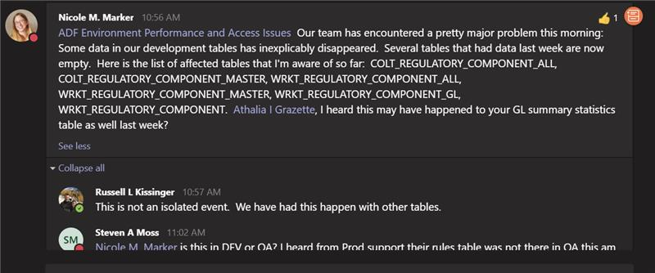
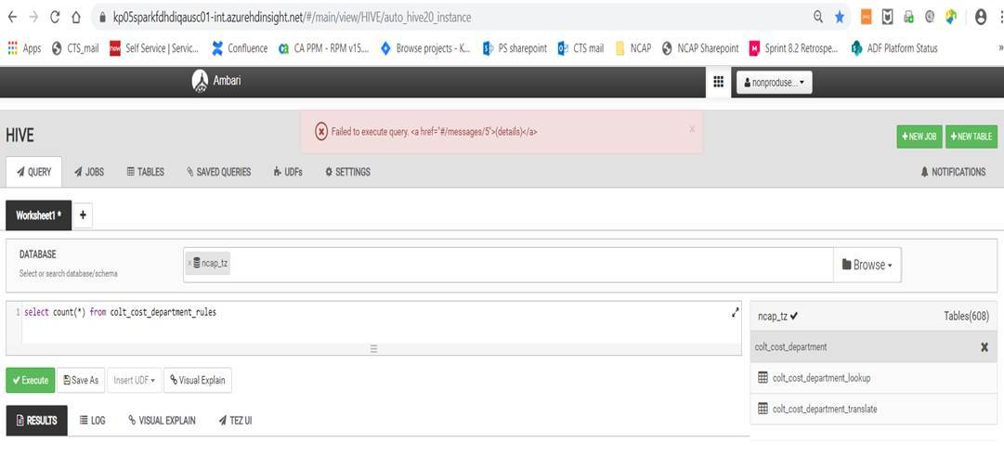
Availability – Example of Recurring Data Availability Issues
Colt_cost_department_rules table is missing in QA.

Slide 64
Continuous Integration – No end-to-end integration testing may be happening as tenants and foundation teams have separate repositories for code management
https://stash.kp.org/projects/NCAP

Slide 65
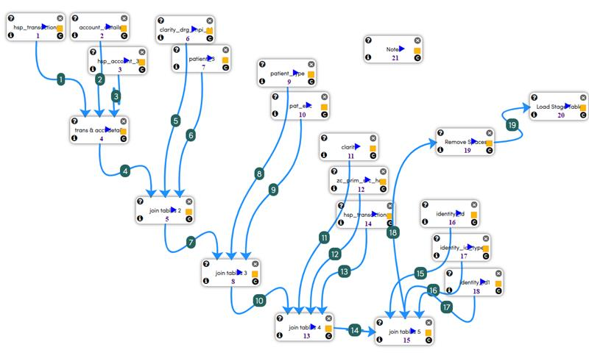
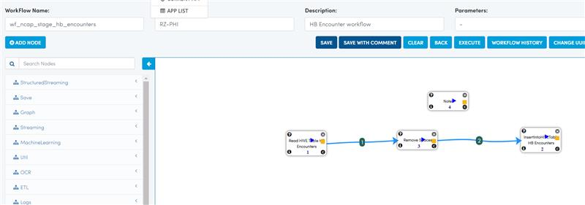
Example DE Tool vs Direct SQL methods (details of slide 57)
Example of ADF recommended workflow with DE Tool nodes sometimes taking 20x longer to complete
Example of direct sql on the same environment taking only 10 minutes to complete

Slide 66
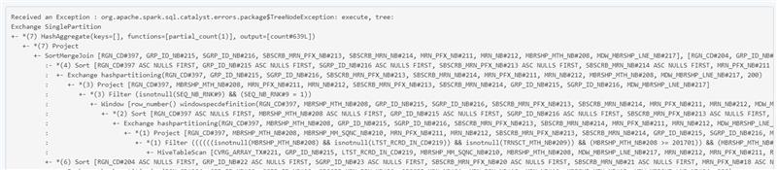
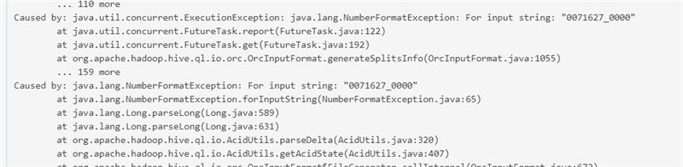
Example workflows sometimes failing in Prod. Supp.
Example of DE tool workflows working in lower environments while sometimes failing in Prod. Supp. Environment during the first deploy

